Slide 1
Big Data Science Mahsa Rahimian University of Colorado Dr. Farnoush kashani Subject of Project: Mall Customers Segmentation — Using Machine Learning Github Links: https://github.com/Mahsa7915/Mahsa/projects/1 https://github.com/Mahsa7915?tab=repositories

Slide 2
Outline
Introduction
technologies
Problem statement
Methods
Tools
challenges
Results
Plans to mitigate challenges
References

Slide 3
introduction
In this Data Science R project, I will execute an interesting application of machine learning called customer segmentation. Customer Segmentation can play crucial role in commercial organization when they are looking for best customer.
Customer Segmentation is a crucial application in unsupervised learning. Cluster techniques can allow commercial companies to identify the several segments of their customers which enable the organization to target the potential user base.
The technologies that I am going to use is Python libraries to implement k-means algorithm.

Slide 4
technologies
I will use TensorFlow as an open source machine learning framework. I decided to use this technology because it is available in Python and C++.
TensorFlow is one of the most well-maintained frameworks for machine learning projects.
This framework has been created by Google to support research objectives but for a short time it widely used by huge companies such as intel, eBay, Twitter and more.
My platform is my local server because I am working on a basic problem and local server can support my project.

Slide 5
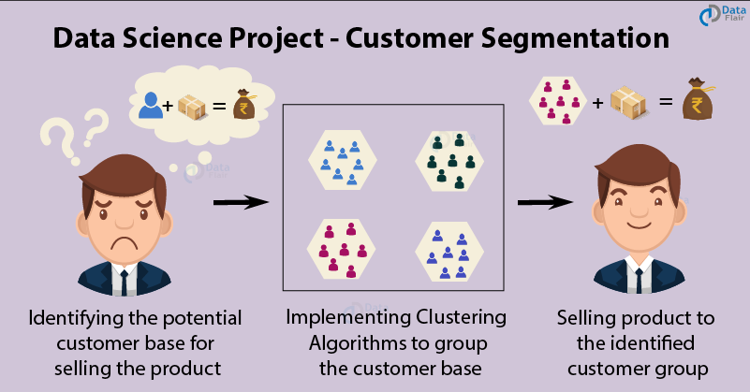
Problem statement
Customer segmentation can divide customers into several groups which share a similarity in different ways that is based on gender, interests, miscellaneous spending habits, and age. This project can help organization to solve a big problem which is target the potential customer for a particular product.

Slide 6
Problem statement
Companies that deploy customer segmentation are under the notion that every customer has different requirements and require a specific marketing effort to address them appropriately. Companies aim to gain a deeper approach of the customer they are targeting.
Thus, they should target the requirements of each and every customer. Accordingly, commercial organizations can gain deeper knowledge about customer’s preferences which will cause maximum profit to the company.

Slide 7
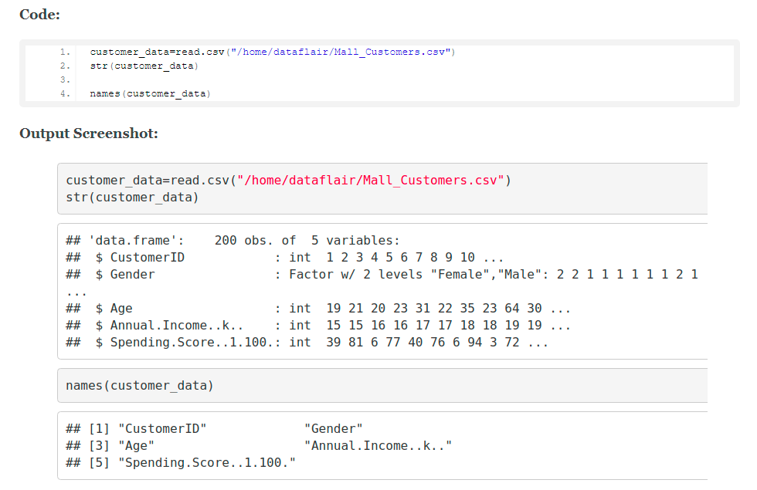
Methods
In the first step of this data science project, we will perform data exploration. We will import the essential packages required for this role and then read our data. Finally, we will go through the input data to gain necessary insights about it.

Slide 8
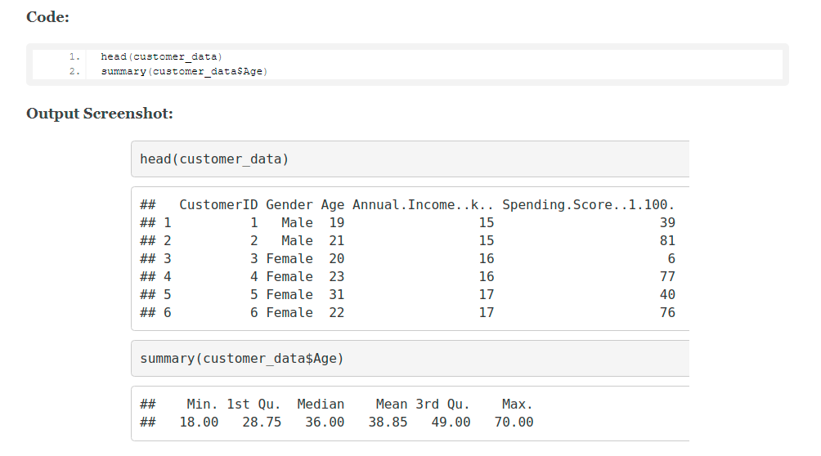
Methods
Now, we display the first six rows of our dataset using the head() function and use the summary() function to output summary of it.

Slide 9
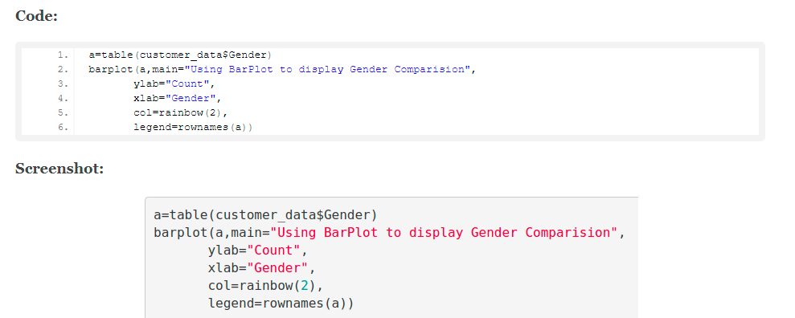
Methods Customer Gender Visualization
In this, we will create a barplot and a piechart to show the gender distribution across our customer data dataset.

Slide 10
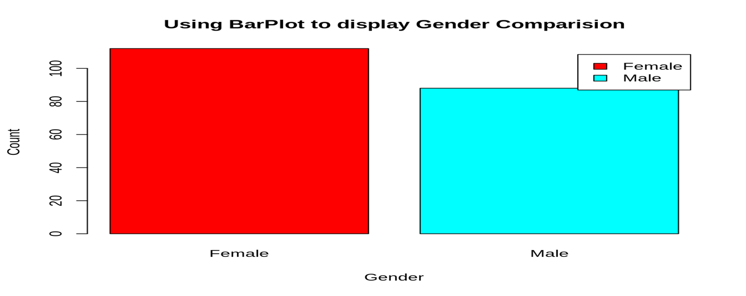
Methods
From this barplot, we observe that the number of females is higher than the males. Now, let us visualize a pie chart to observe the ratio of male and female distribution.

Slide 11
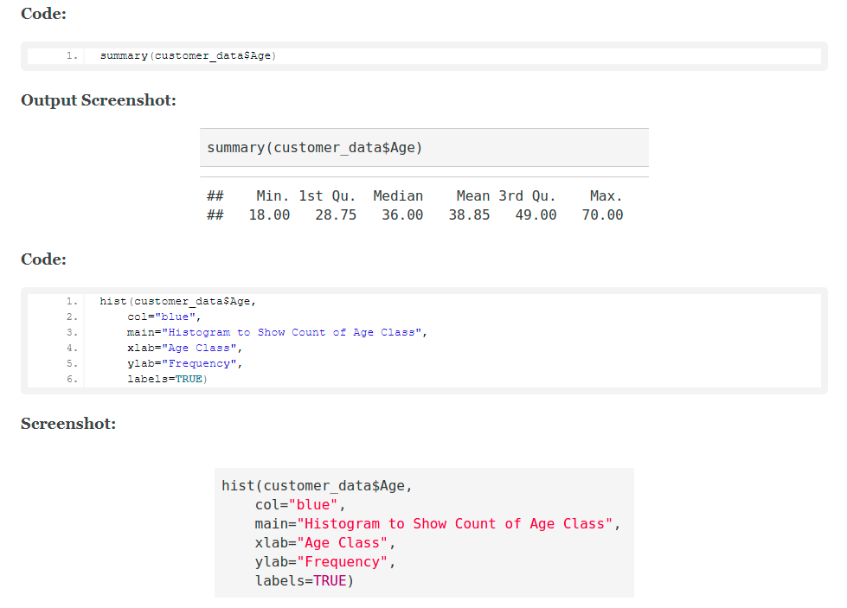
Methods Visualization of Age Distribution
Now lets plot a histogram to view the distribution to plot the frequency of customer ages. We will first proceed by taking summary of the Age variable.

Slide 12
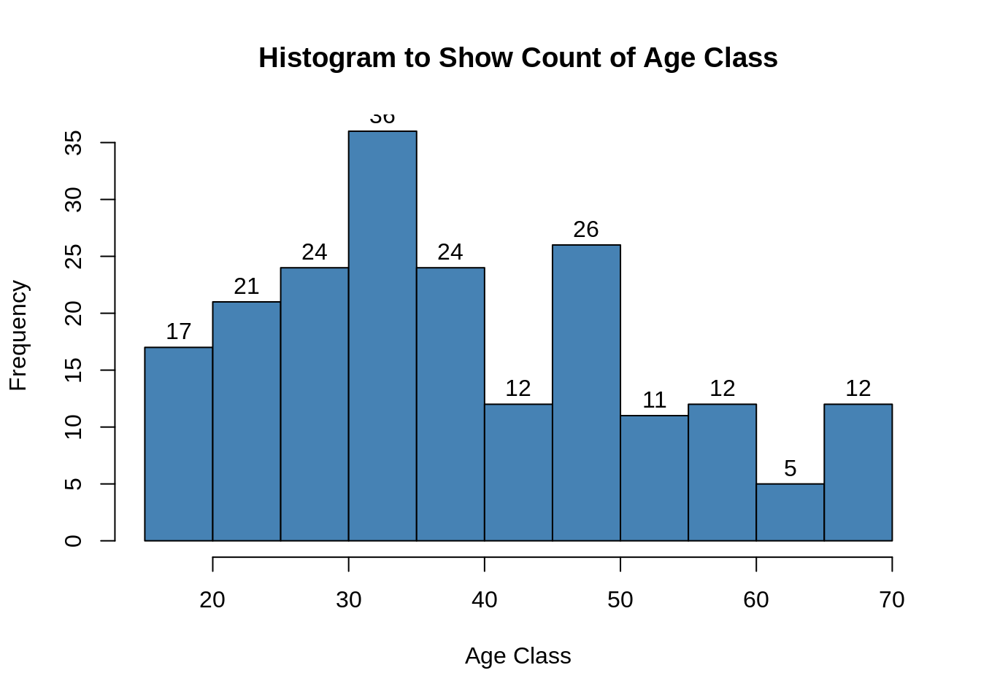
Methods

Slide 13
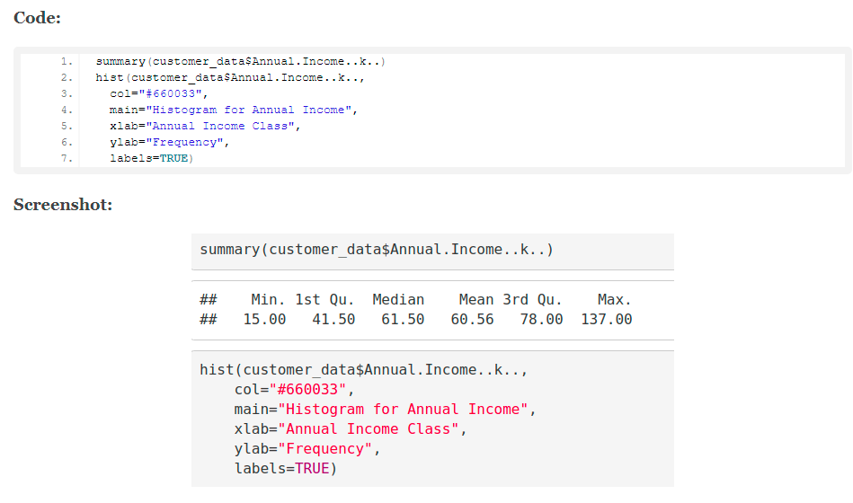
Methods Analysis of the Annual Income of the Customers
In this section of the project, we will create visualizations to analyze the annual income of the customers. We will plot a histogram and then we will proceed to examine this data using a density plot.

Slide 14
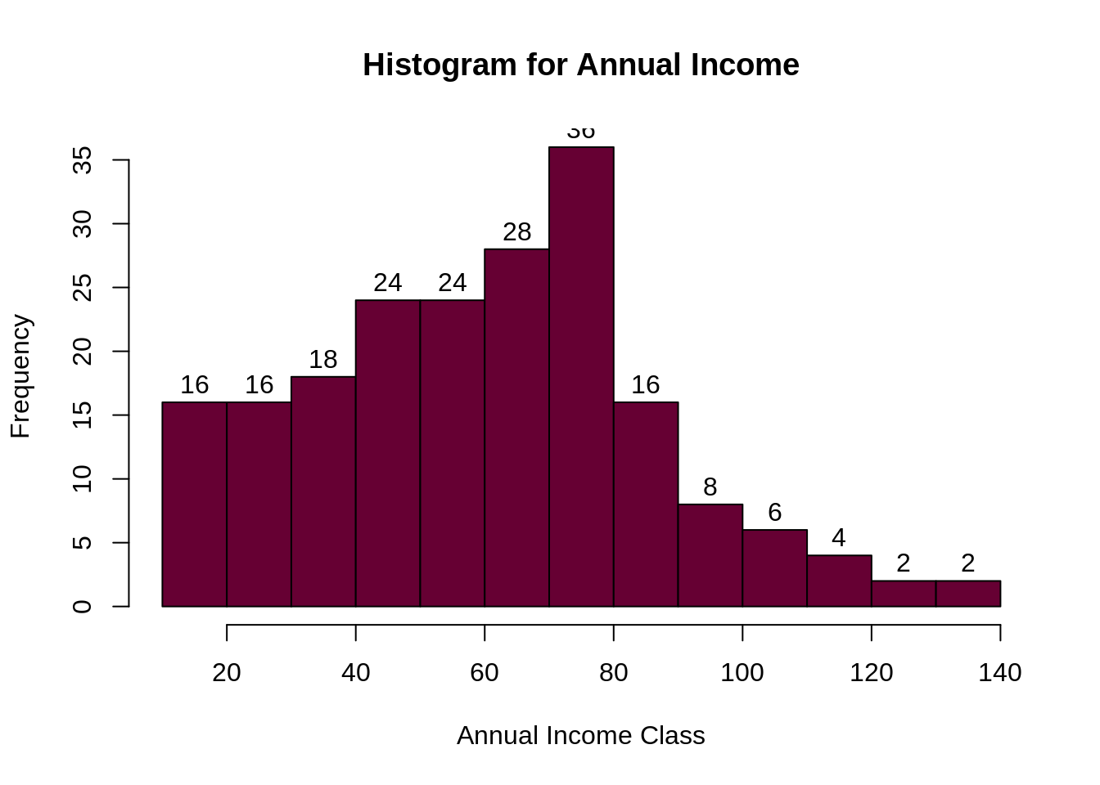
output

Slide 15
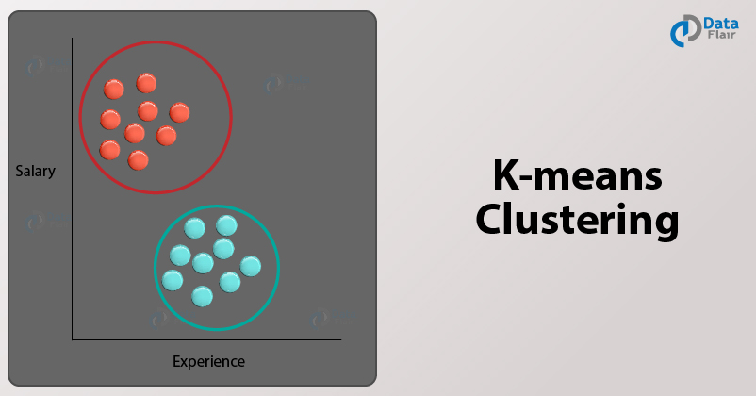
tools
One of the most popular Machine Learning algorithms is K-means clustering. It is an unsupervised learning algorithm, meaning that it is used for unlabeled datasets. Imagine that you have several points spread over an n-dimensional space.

Slide 16
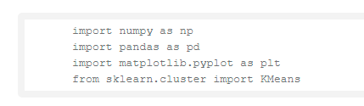


tools
We can use K-means over random data using Python libraries.
1. First, we import the essential Python Libraries required for implementing our k-means algorithm
2. We then randomly generate 200 values divided in two clusters of 100 data points each.
3. We proceed to plot our generated random values and obtain the following graph.

Slide 17
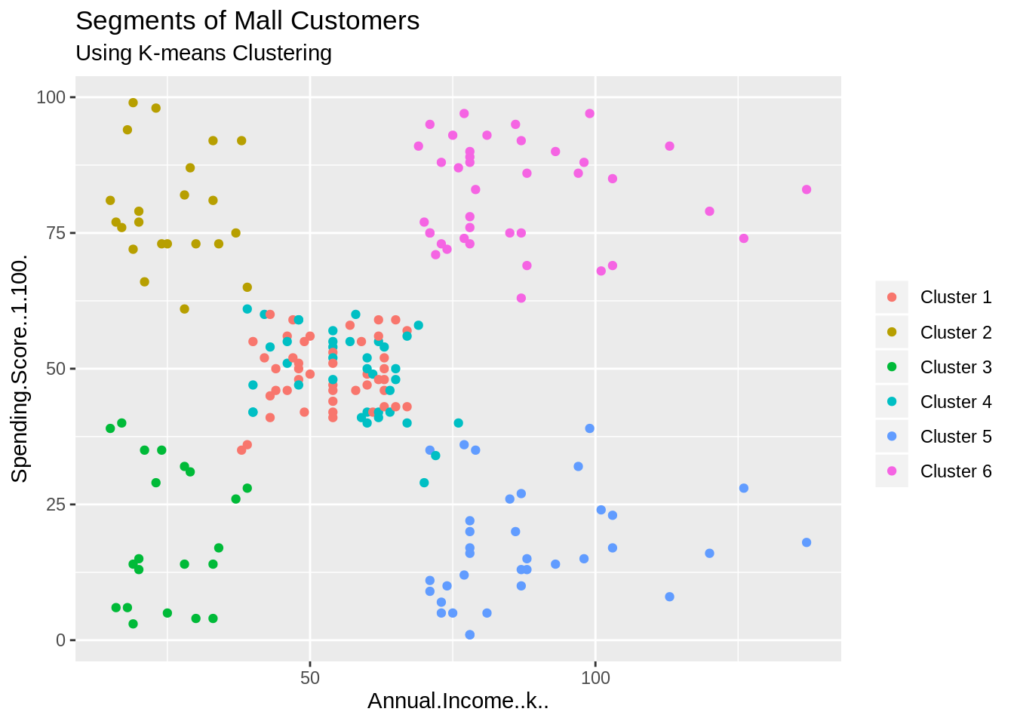
Result segments of mall customers

Slide 18
Result
From the above visualization, we observe that there is a distribution of 6 clusters as follows:
Cluster 6 and 4
Cluster 1
Cluster 3
Cluster 2
Cluster 5

Slide 19
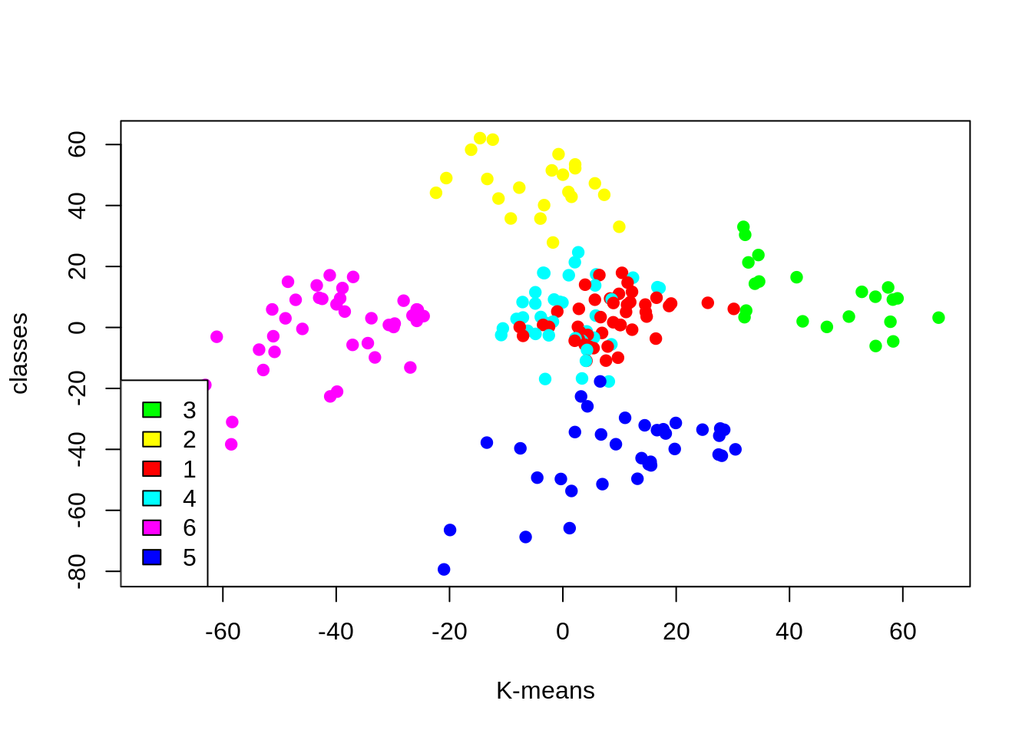
Result
Cluster 4 and 1
Cluster 6
Cluster 5
Cluster 3
Cluster 2

Slide 20
results
In this data science project, as you know we went through customer segmentation model. We used a class of machine learning called unsupervised learning. As I mentioned in this report, we used a clustering algorithm called k-means clustering. In this project we learned how effective is this K-means clustering in this project. We analyzed and visualized the data and then proceeded to implement our algorithm.

Slide 21
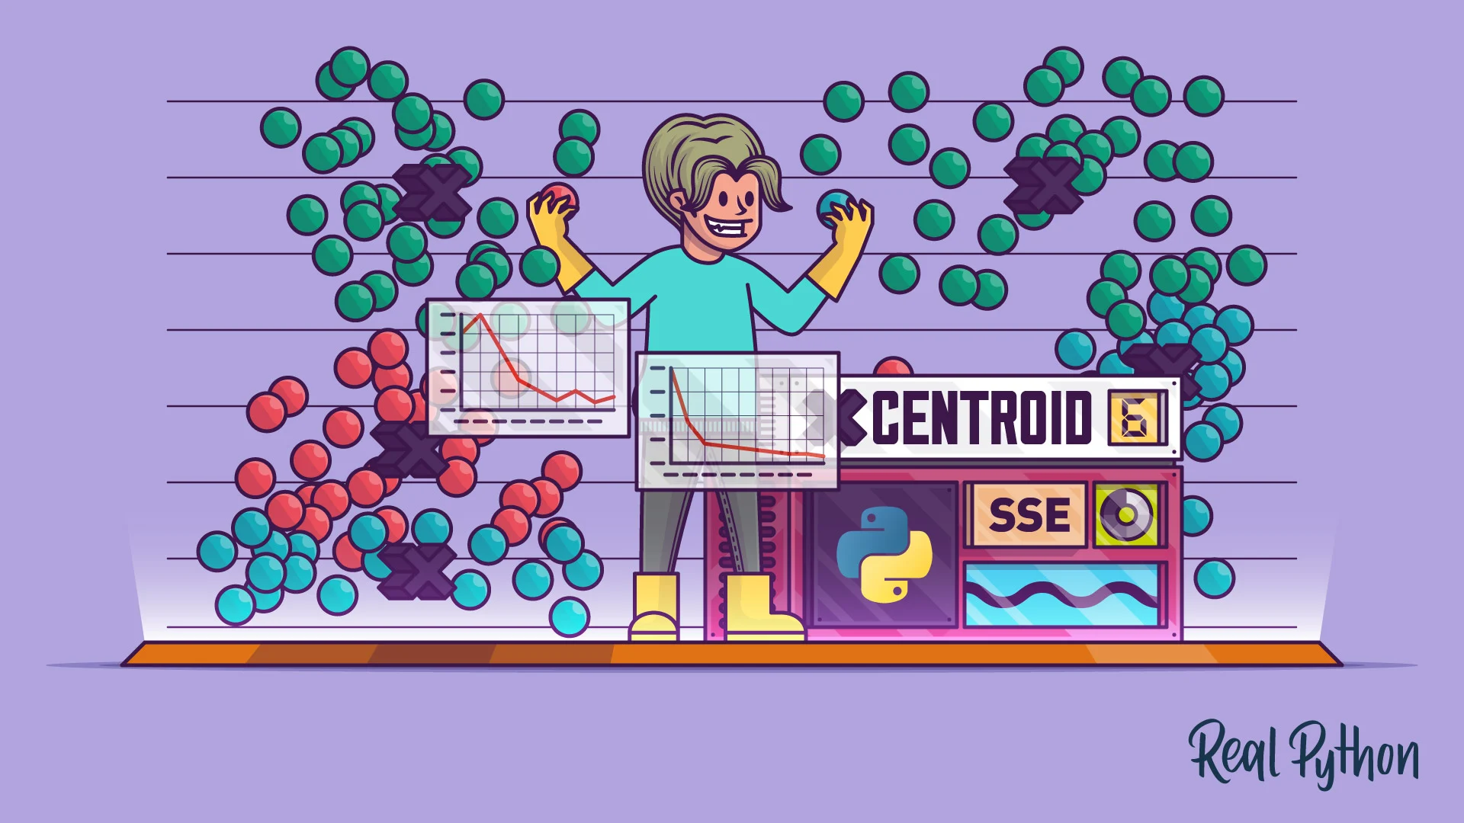
Plans to mitigate challenges
the number of clusters (k) that we wish to produce in the final output is a challenge.
On the other hand, While working with clusters, you need to specify the number of clusters to use.

Slide 22
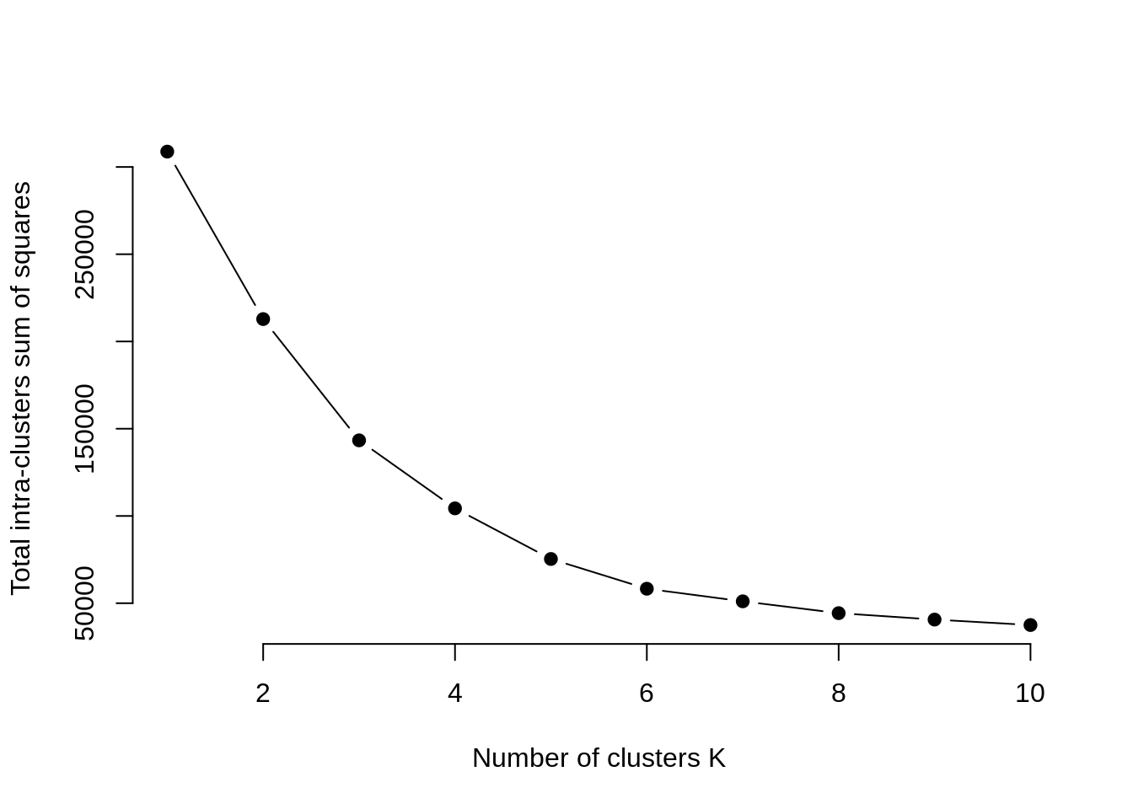
Plans to mitigate challenges Number of clusters k

Slide 23
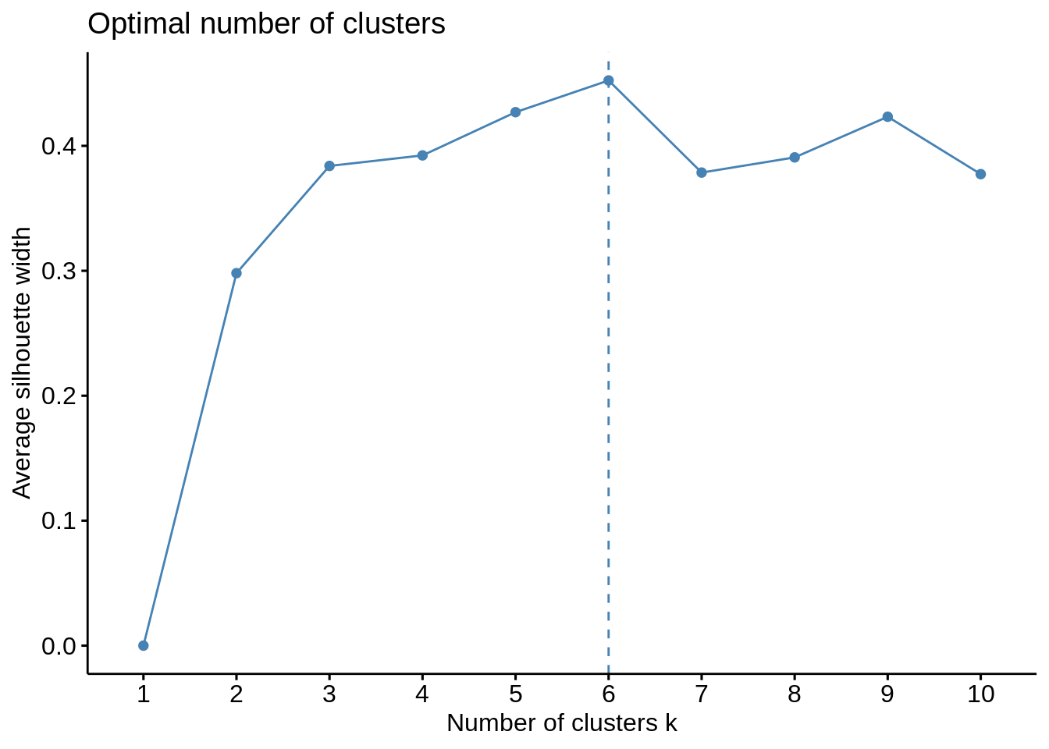
Plans to mitigate challenges Optimal number of clusters
Using the gap statistic, one can compare the total intracluster variation for different values of k along with their expected values under the null reference distribution of data. With the help of Monte Carlo simulations, one can produce the sample dataset.

